Slide 1
Introduction
In today’s scenario, Optimization of resources is a must in every field like enterprise, start-ups, project management etc.
Optimization of resources is the set of processes and methods to match the available resources (human, machinery, financial) with the needs of the organization in order to achieve established goals.
For any organization, it is important to choose the resources wisely to get maximum profit.
MaxYourBag is a tool that is use to provide combinatorial optimization (It often involves determining the way to efficiently allocate resources used to find solutions to mathematical problems).

Slide 2
Introduction
This tool uses Knapsack algorithm : Given a set of items, each with a weight and a value, determine the number of each item to include in a collection so that the total weight is less than or equal to a given limit and the total value is as large as possible.
Basically, it works on a very simple approach of getting maximum output/profit by using minimum resources and that is the need of any organization.

Slide 3
Literature review
MaxYourBag is the best tool for resource requirement management. To get maximum profit in time efficient manner using knapsack algorithm. Here is the conclusion of some of the reference paper that we reviewed to make our project better and to know more technologies that we can include in our system.
B.S.K.REDDY, SK. NAGARAJU, MD.SALMAN (2015). ‘A study on optimization of resources for multiple projects by using primavera’ vol. 10, No. 2, School of engineering, Taylor’s university (2), Resources play vital role in construction projects. The performance of construction industry depends chiefly on how best the resources are managed.
Optimization play pivotal role in resource management, but task is highly haphazard and chaotic under the influence of complexities and vastness.
Management always looks for optimum utility of resources available with them.
Hence, the project management has got important place especially in resource management and smooth functioning with allocated budget.
To achieve these goals and to exercise enhance optimization certain tools are used for resource allocation optimally. Present work illustrates resource optimization exercises on two ongoing projects in Dubai, UAE.

Slide 4
Literature review
Resource demands of project A & B are individually leveled and observed cumulative requirement is 17475. In other option demands of projects A & B are aggregated and then together leveled, the necessary resource observed is 16490.
Comparison of individually leveled and then combined option with aggregated and then leveled clearly indicates reduction in demand of resources by 5.65% in later option, which could be best considered for economy.
Nasim Ferdosian, Mohamed Othman, Borhanuddin Mohd Ali, Kweh Yeah Lun (2016). ‘Greedy knapsack algorithm for downlink resource allocation’ ed. 1, Communication technology and network department in University of Putra, Malaysia (1), in this paper, a greedy algorithm was presented to evaluate user candidates which are waiting for scheduling and select an optimal set of users to maximize system performance, without exceeding available bandwidth capacity.
The greedy knapsack algorithm is defined as an optimal solution to the resource allocation problem, formulated based on the fractional knapsack problem. A compromise between throughput and QoS provisioning is obtained by proposing a class-based ranking function, which is a combination of throughput and QoS related parameters defined for each application. The simulation results show that the proposed method provides high performance in terms of throughput, loss and delay for different classes of QoS over the existing ones, especially under overload traffic.

Slide 5
Problem statement
Every professional faces a problem of how to manage their recourses in an efficient and profitable manner.
In every firm, this is a basic conflict one has to face whether the investment is resources efficient or time efficient.
And how can the user manage and choose resources efficiently within a few clicks.
This is easily solved by using MaxYourBag and can save a lot of time of the user.

Slide 6
Objectives
Following are the main objective of our software:
Time efficient tool as you just have to put up resources and values and then it gives you maximum optimization possible.
It helps you getting maximum value from minimum resources.
It also helps in stock picking and to make better investment decisions in stock marketing.

Slide 7
Methodology
Here we are using Agile Model and following are the steps:
1. Requirement Gathering and analysis - the main requirements or the needs of today's corporative world is that all the companies want there work to be done in a time efficient and a profitable manner and it can be done by the proper planning of resources that are used and by choosing the invested resources wisely which can be done by a tool or a software.
2. Architecture and design - Now when, we know the need of any organization or startup, we need a software that would work on Combinatorial Optimization. This software would tell us how to get maximum profit/value with low number of resources in a time efficient manner on the basis of number of resources and the value or weightage of each resource.

Slide 8
Methodology
3. Development – Now, for the development process, we have to figure out the algorithm. We are using the Knapsack Algorithm for the project using C++.
4. Testing - And finally, during testing process, it gives desired output as a software which is able to calculate how to get maximum output using a low number of resources.

Slide 9
Experimental Setup
Hardware requirements - 64-bit operating system, x64-based processor Processor - Intel® core™ i5-8250U CPU @ 1.60 GHz RAM – 8 GB
Software requirements - Microsoft Visual Studio Code C++, MINGW software development environment.
Minimum requirements on client/user End - 32-bit operating system, x32-based processor Processor - Intel® core™ i5-8250U CPU @ 1.60 GHz 1.80 GHz RAM – 4 GB Web browser – any web browser like Chrome, Microsoft edge etc.

Slide 10
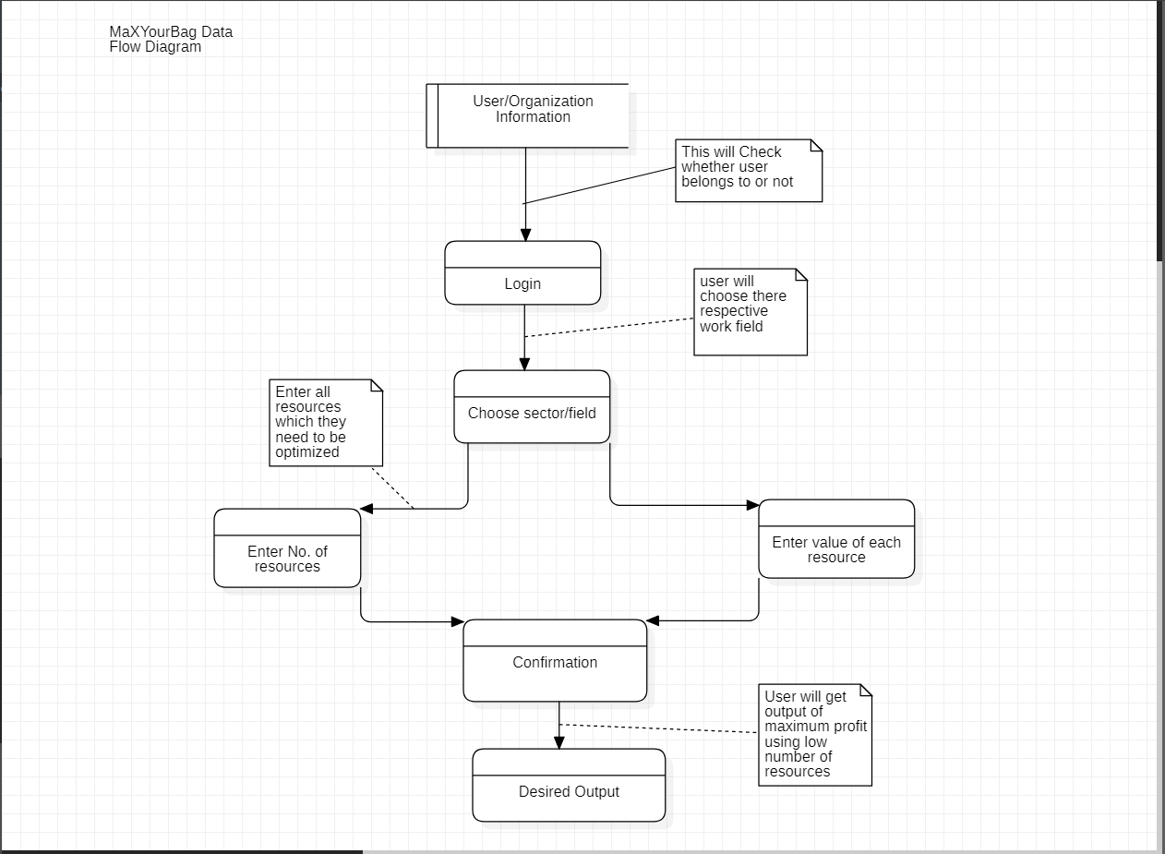
Data flow diagram

Slide 11
Algorithmic Approach
We are using Knapsack algorithm.
The knapsack problem is a problem in combinatorial optimization: Given a set of items, each with a weight and a value, determine the number of each item to include in a collection so that the total weight is less than or equal to a given limit and the total value is as large as possible.
It is a pseudo-polynomial time algorithm using dynamic programming.

Slide 12


Algorithmic Approach
The most common problem being solved is the 0-1 knapsack problem, which restricts the number x_{i} of copies of each kind of item to zero or one. Given a set of n items numbered from 1 up to n each with a weight w_{i} and a value v_{i} along with a maximum weight capacity W,
maximize
subject to
Here x_{i} represents the number of instances of item i to include in the knapsack. Informally, the problem is to maximize the sum of the values of the items in the knapsack so that the sum of the weights is less than or equal to the knapsack's capacity.
$$\sum_{i=0}^{n}{\text{v}\text{i}\text{x}\text{i}}$$
$$\sum_{i=0}^{n}{\text{w}\text{i}\text{x}\text{i} \text{≤} W} \text{x}\text{i} \text{∈} \left\{0,1\right\}.$$
and

Slide 13
References
Nasim Ferdosian, Mohamed Othman, Borhanuddin Mohd Ali, Kweh Yeah Lun, ‘Greedy knapsack algorithm for downlink resource allocation’ https://arxiv.org/pdf/1601.03461.pdf
B.S.K.REDDY, SK. NAGARAJU, MD.SALMAN, ‘A study on optimization of resources for multiple projects by using primavera’ https://jestec.taylors.edu.my/Vol%2010%20issue%202%20February%202015/Volume%20(10)%20Issue%20(2)%20235-248.pdf
Resource management in software as a service using the knapsack problem model https://www.sciencedirect.com/science/article/pii/S0925527311005275
0-1 knapsack problem https://www.geeksforgeeks.org/0-1-knapsack-problem-dp-10/
Knapsack algorithm https://en.wikipedia.org/wiki/Knapsack_problem

